Slide 1

Catalytic Pyrolysis Of Biomass: A Review Of Recent Research
Ch. Sai Goutham
23H51A6208
CSC-A

Slide 2
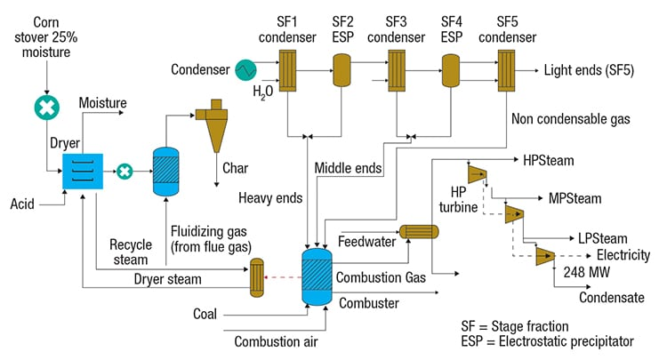
Introduction to Catalytic Pyrolysis
Catalytic pyrolysis is a thermochemical process that converts biomass into valuable bio-oils and gases.
This process enhances the yield and quality of biofuels compared to conventional pyrolysis.
Recent research has focused on optimizing catalysts to improve efficiency and reduce costs.
Notes:
Image source: https://www.chemengonline.com

Slide 3
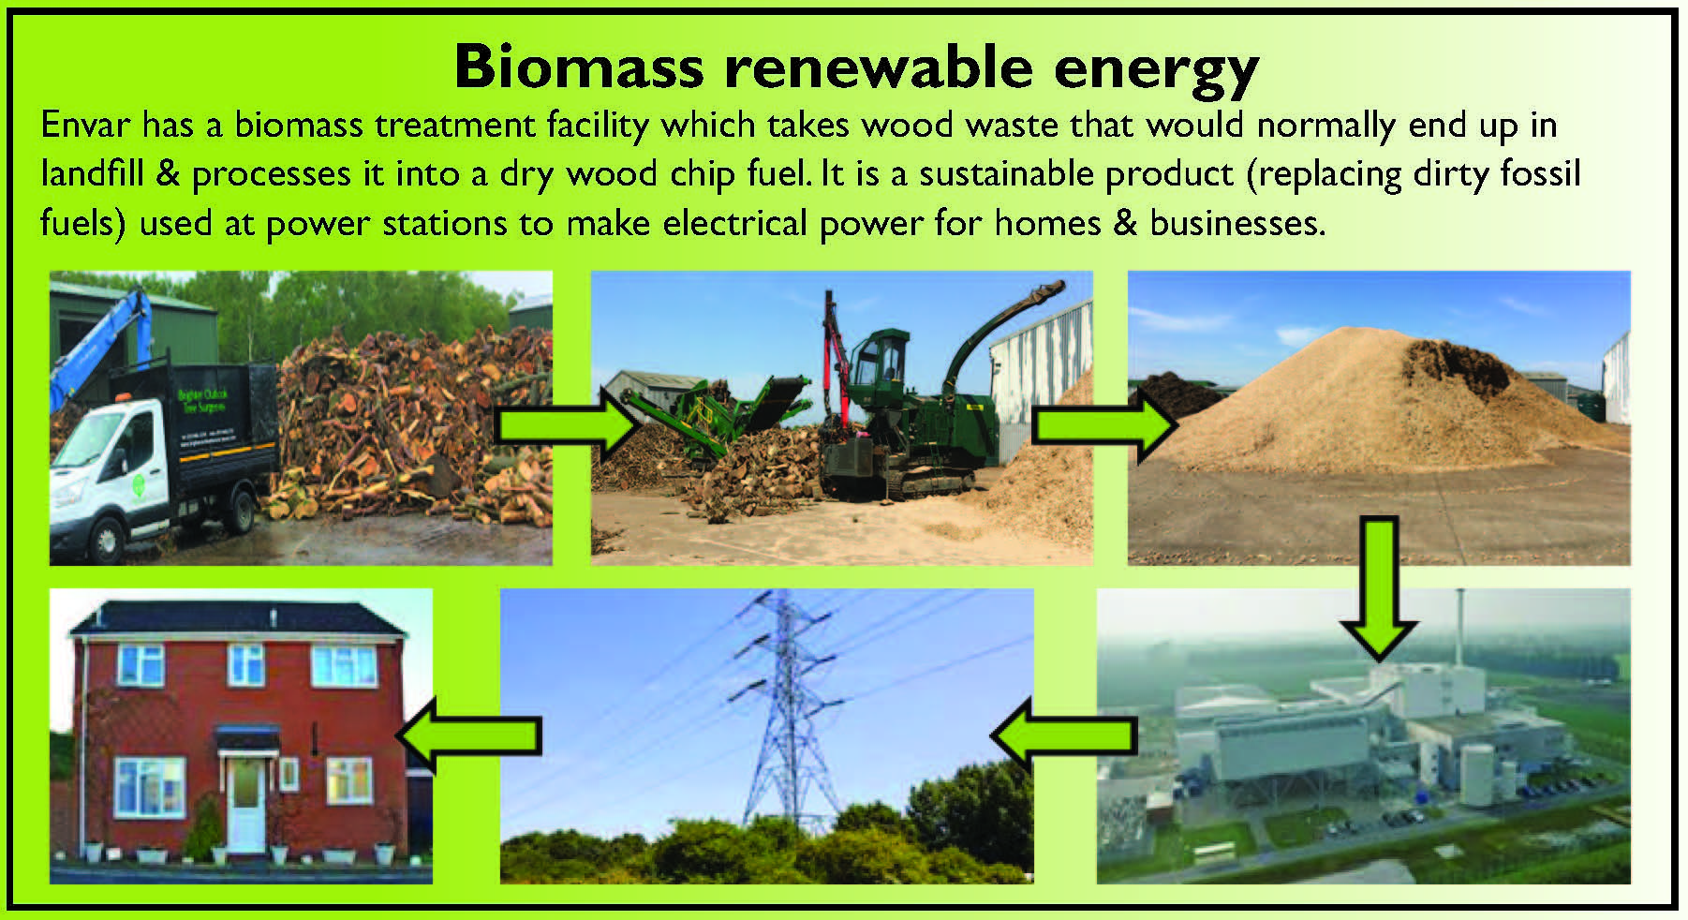
Importance of Biomass Utilization
Biomass is a renewable energy source that can reduce dependency on fossil fuels.
It contributes to greenhouse gas mitigation by sequestering carbon during growth.
Efficient conversion technologies are crucial for maximizing energy recovery from biomass.
Notes:
Image source: https://www.envar.co.uk

Slide 4
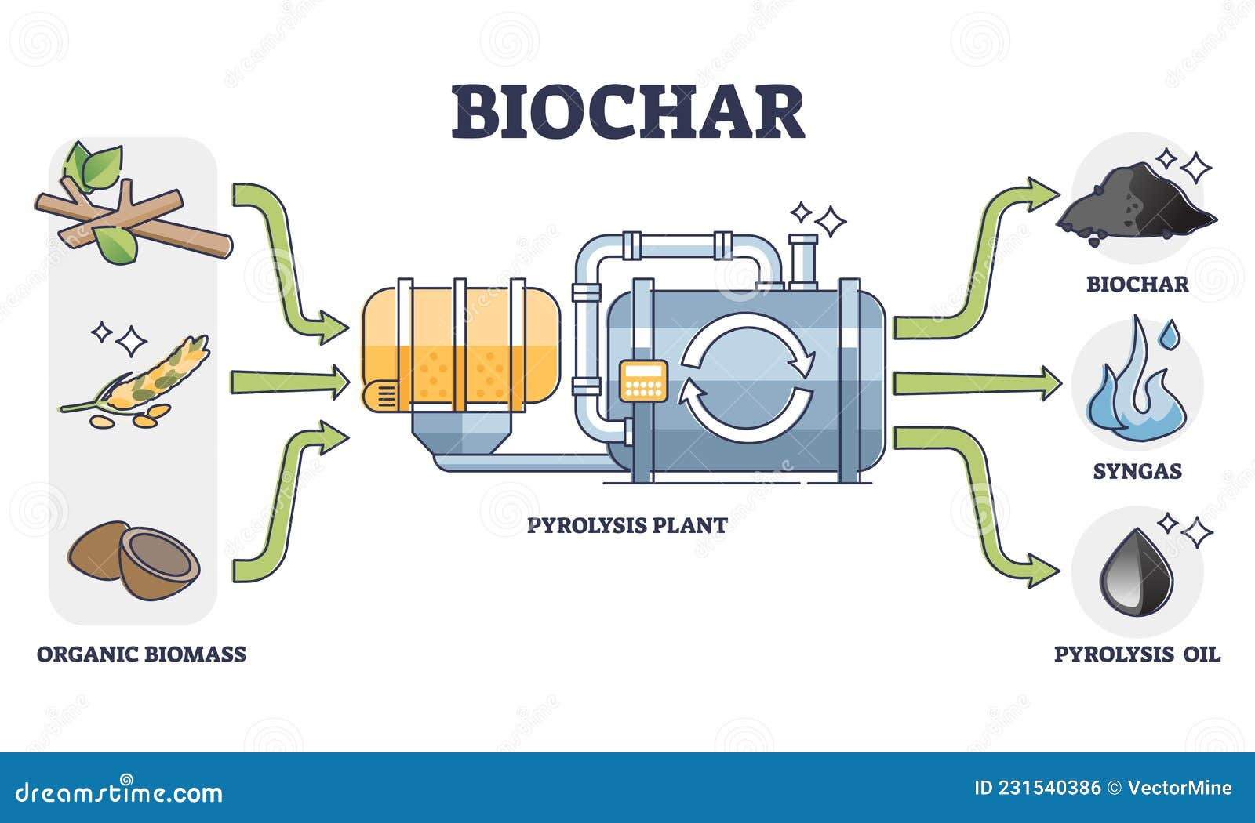
Pyrolysis Process Overview
Pyrolysis involves heating organic materials in the absence of oxygen to decompose them.
The process generates bio-oil, char, and syngas, which can be further refined.
Catalytic pyrolysis incorporates catalysts to enhance product selectivity and yield.
Notes:
Image source: https://thumbs.dreamstime.com

Slide 5
Catalysts Used in Biomass Pyrolysis
Various catalysts, including zeolites, metal oxides, and biochar, have been explored in research.
Each type of catalyst affects the composition of bio-oil and the efficiency of the process.
The choice of catalyst is critical for optimizing product properties and economic feasibility.
Notes:
Image source: https://www.researchgate.net

Slide 6
Mechanisms of Catalytic Pyrolysis
Catalysts facilitate chemical reactions that break down biomass into smaller molecules.
They can alter reaction pathways, leading to different product distributions.
Understanding these mechanisms is essential for designing effective catalytic systems.
Notes:
Image source: https://www.researchgate.net

Slide 7
Recent Advances in Catalytic Materials
Novel catalysts, such as supported metal catalysts and bio-derived catalysts, have shown promising results.
Research has demonstrated improvements in bio-oil quality through enhanced catalytic activity.
Innovations in catalyst design aim to address challenges like catalyst deactivation and recycling.
Notes:
Image source: https://www.researchgate.net

Slide 8
Bio-Oil Composition and Quality
The quality of bio-oil is influenced by the type of biomass and the catalyst used.
High-quality bio-oil contains valuable chemicals that can be upgraded to transportation fuels.
Recent studies focus on tailoring catalysts to produce specific bio-oil fractions.
Notes:
Image source: https://0.academia-photos.com

Slide 9
Environmental Benefits of Catalytic Pyrolysis
Catalytic pyrolysis can help reduce waste by converting lignocellulosic materials into energy.
The process has a lower carbon footprint compared to traditional fossil fuel extraction.
Effective biomass conversion supports sustainable energy goals and circular economy principles.
Notes:
Image source: https://pubs.acs.org

Slide 10
Economic Viability of Catalytic Pyrolysis
The economic feasibility of catalytic pyrolysis depends on biomass feedstock availability and costs.
Technological advancements are required to reduce operational and capital expenditures.
Recent models predict enhanced profitability through integrated biorefineries utilizing pyrolysis.
Notes:
Image source: https://www.researchgate.net

Slide 11
Challenges in Catalytic Pyrolysis
Catalyst deactivation remains a significant challenge in maintaining process efficiency.
There is a need for standardized testing methods to compare catalyst performance.
Addressing feedstock variability is essential for consistent product quality in pyrolysis.
Notes:
Image source: https://www.researchgate.net

Slide 12
Future Research Directions
Future research is likely to focus on developing more robust and efficient catalysts.
Integration of catalytic pyrolysis with other biomass conversion technologies is a promising area.
Investigating the life-cycle impacts of catalytic pyrolysis can provide a comprehensive understanding.
Notes:
Image source: https://www.researchgate.net

Slide 13
Conclusion
Catalytic pyrolysis of biomass presents a viable pathway for sustainable energy production.
Recent research highlights the importance of catalyst optimization for improving outcomes.
Continued investment and innovation are essential for realizing the full potential of this technology.
Notes:
Image source: https://www.researchgate.net

